Slide 1
REINFORCEMENT LEARNING-The Intuition Behind
Erol Kazancli
KI-LABS

Slide 2
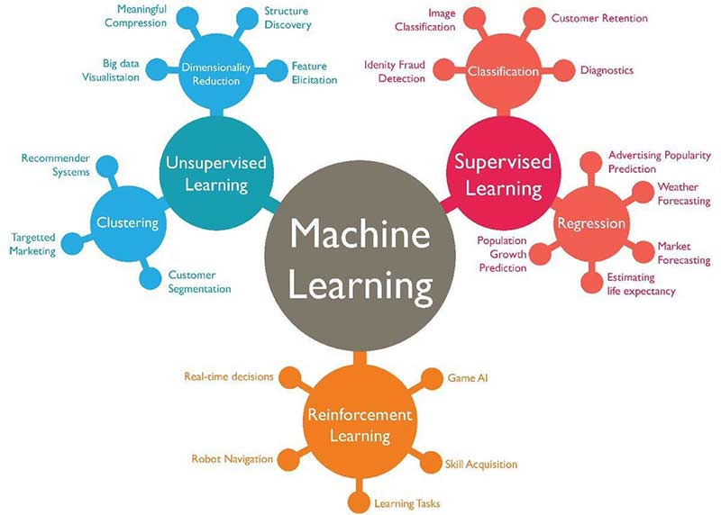
REINFORCEMENT LEARNING
Reinforcement learning is learning how to act—how to map situations to actions—so as to maximize a numerical reward signal.
The learner must discover which actions yield the most reward by trying them.
Reinforcement learning is considered to be a third machine learning paradigm, alongside supervised learning and unsupervised.
Core algorithms of reinforcement learning were originally inspired by biological learning systems.
Image retrieved from https://www.techleer.com/articles/203-machine-learning-algorithm-backbone-of-emerging-technologies/

Slide 3
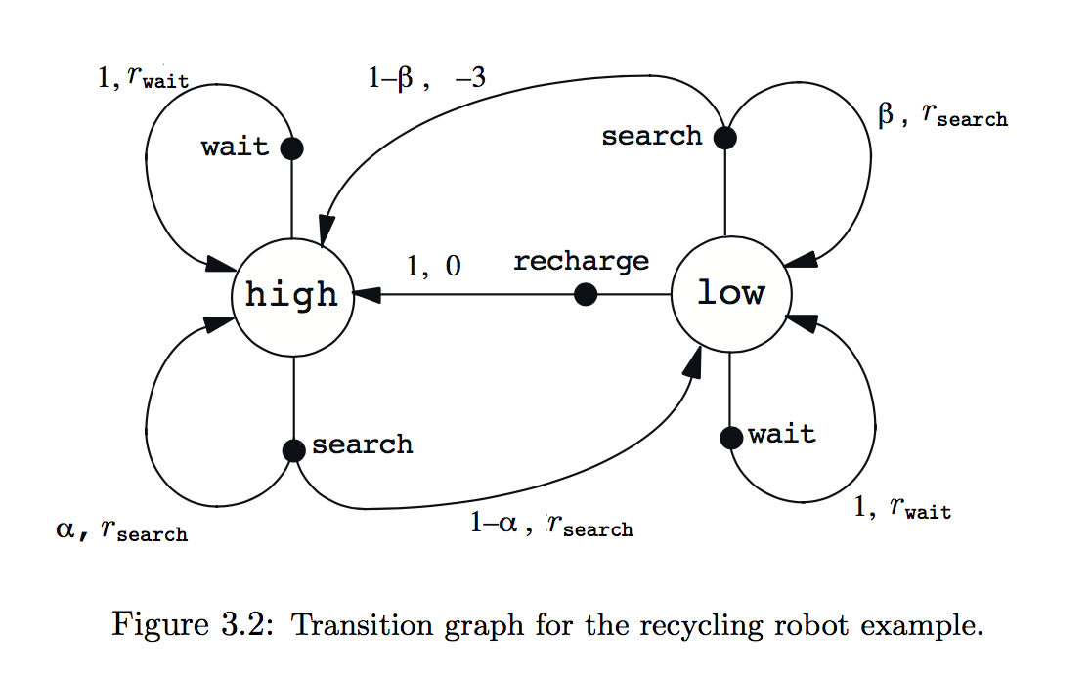
Markov Decision Processes
MDPs are a classical formalization of sequential decision making, where actions influence not just immediate rewards, but also subsequent situations, or states, and through those future rewards.
MDPs are a mathematically idealized form of the reinforcement learning.
The learner and decision maker is called the agent.
Image retrieved from: Reinforcement Learning: An Introduction, Richard S. Sutton and Andrew G. Barto

Slide 4
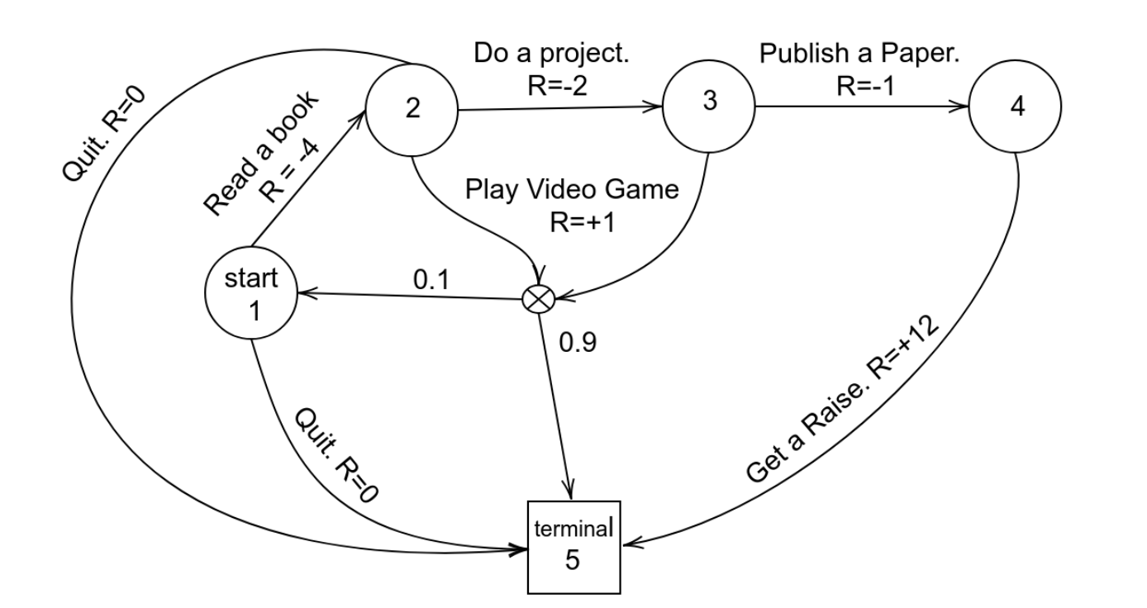
Markov Decision Processes
A set of states
A set of actions
Transition function T(s, a, s’)
Reward function R(s, a, s’)
Sometimes Starting and Terminal states
Image retrieved from https://programmingbee.net/2019/01/01/rl-part-3-markov-decision-process-policy-bellman-optimality-equation/

Slide 5
State
Reinforcement learning relies heavily on the concept of state.
The agent state is the agent’s internal representation i.e. whatever information the agent uses to pick the next action i.e.
Informally, state is “how the environment is” at a particular time. Think of the state as whatever information is available to the agent about its environment.

Slide 6
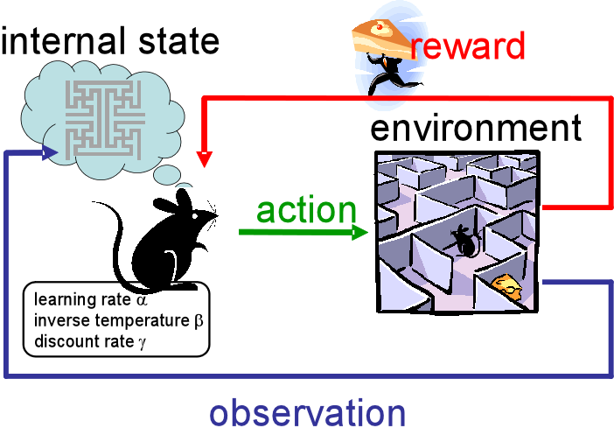
Reward
With each action, the environment sends to the agent a single number called the reward. The agent’s sole objective is to maximize the total reward it receives over the long run.
Analogous to the experiences of pleasure or pain.
In general, reward signals may be stochastic functions of the state of the environment and the actions taken.
Retrieved from
https://becominghuman.ai/the-very-basics-of-reinforcement-learning-154f28a79071

Slide 7


Returns and Episodes
Return is the sum of the rewards:
Makes when there is a natural notion of final time step, that is, we have episodes, such as plays of a game, trips through a maze, or any sort of repeated interaction.
Each episode ends in a special state called the terminal state, followed by a reset to a standard starting.
The next episode begins independently of how the previous one ended.
Episodic vs. Continuous tasks

Slide 8
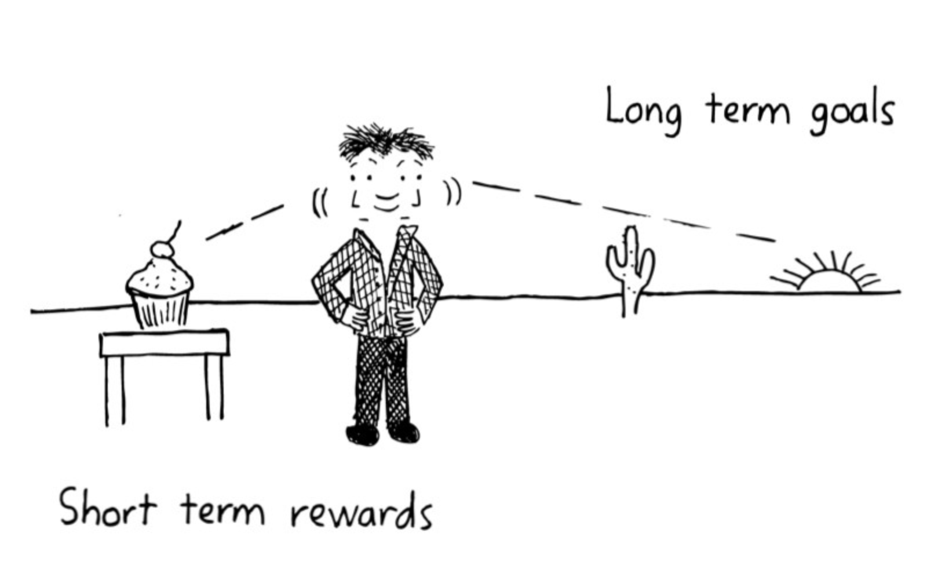


Value function (Q-Value)
Expected amount of total reward over the future, starting from that state.
Value function specifies what is good in the long run, i.e. long-term desirability of states or actions.
A state or an state-action pair might always yield a low immediate reward but still have a high value because it is regularly followed by other states that yield high rewards.

Slide 9
Reward vs. Value
We look for actions that has the highest value, not highest reward, because the total amount of reward obtained over the long run is bigger.
It is much more difficult to determine values than it is to determine rewards.
Rewards are basically given directly by the environment, but values must be estimated and re-estimated from the experience an agent has over its entire lifetime.
The most critical component of almost all reinforcement learning algorithms is finding methods for efficiently estimating values.

Slide 10
Policy
A policy is the agent’s behavior. It is a mapping from state to action.
It can be a simple function or lookup table, or it may involve extensive computation such as a search process.
It alone is sufficient to determine behavior.
Policies may be deterministic or stochastic.
An optimal policy is the policy that maximizes expected reward.
Greedy vs. random policies. (ϵ-greedy)

Slide 11
Model
Model of the environment: How the environment will behave. e.g. given a state and action, the model predicts next state and next reward.
Models are used for planning.
Model-based methods vs. model-free methods.

Slide 12
Exploration vs. Exploitation
Exploitation is preferring actions that has been tried and and found to be effective in producing reward. e.g. Going to your preferred restaurant
Exploration is trying actions that has not been selected before in the hope of finding high reward producing actions. e.g. Trying a new restaurant

Slide 13
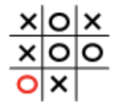
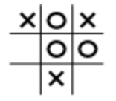
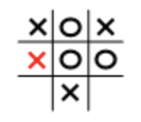
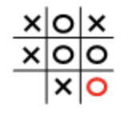
EXAMPLE: TIC TAC TOE
Current State Action Next State
Images retrieved from https://www.eleceng.adelaide.edu.au/students/wiki/projects/index.php/Projects:2015s1-42_Rule-based_AI_Agent_Development:_Tic_Tac_Toe

Slide 14
TIC TAC TOE
Tic-tac-toe has a relatively small, finite state set. It is model-free: it has no model of its opponent of any kind.
Reinforcement learning can be used when the state set is very large, or even infinite. e.g. Backgammon has 10²⁰ states. Go has 10¹⁷⁰ states Helicopter flying has infinite state space.
When the number of states is large, algorithms who can generalize over unobserved states are effective (neural networks, deep reinforcement learning)

Slide 15
Methods for Reinforcement Learning
Dynamic programming methods are well developed mathematically, but require a complete and accurate model of the environment.
Monte Carlo methods don’t require a model and are conceptually simple, but are not well suited for step-by-step incremental computation.
Temporal-difference methods require no model and are fully incremental, but are more complex to analyze.

Slide 16
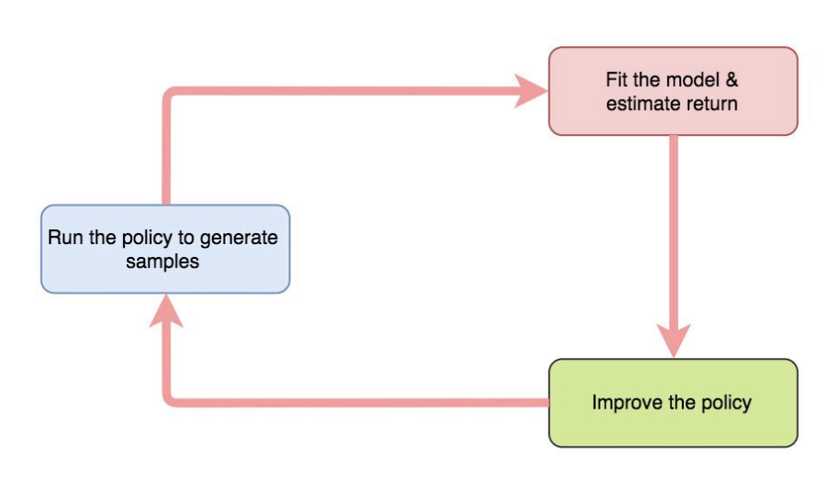
Methods
Image retrieved from https://medium.com/@jonathan_hui/rl-value-learning-24f52b49c36d

Slide 17

Dynamic Programming - Bellmann Equations
Expressing the value function recursively in terms of the next states value.
Image retrieved from https://programmingbee.net/2019/01/01/rl-part-3-markov-decision-process-policy-bellman-optimality-equation/

Slide 18
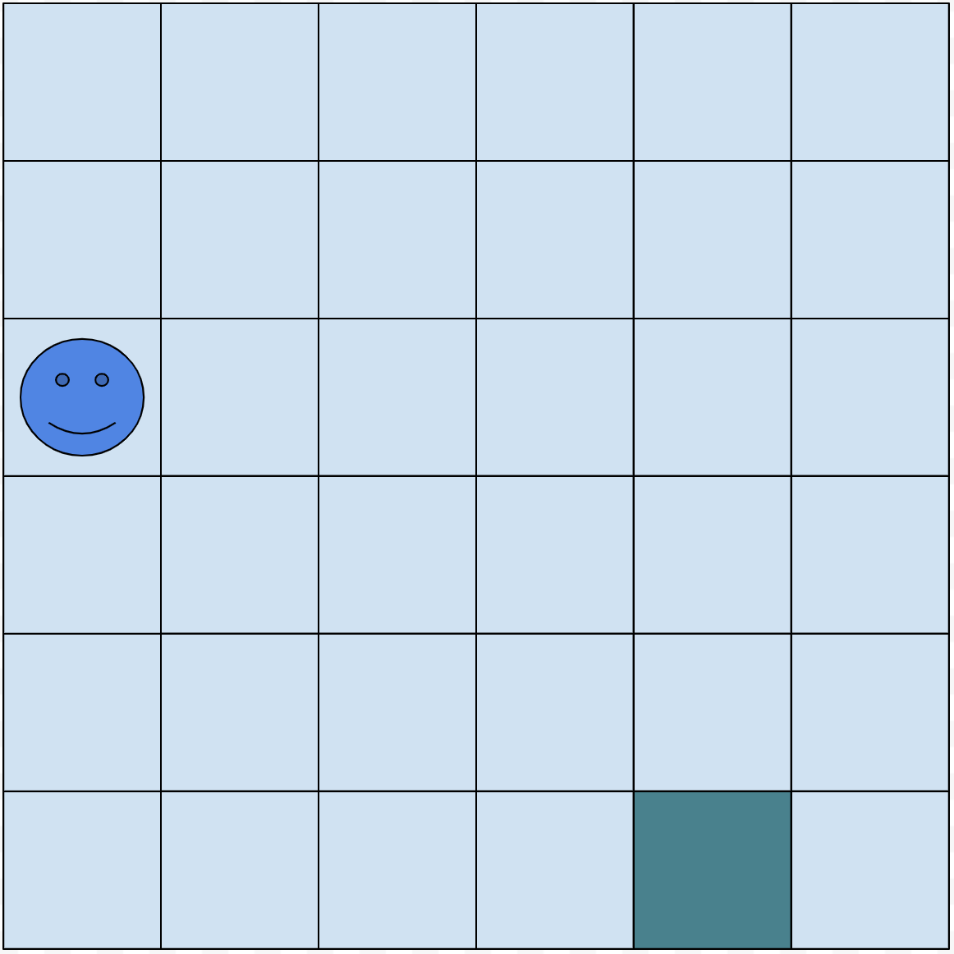
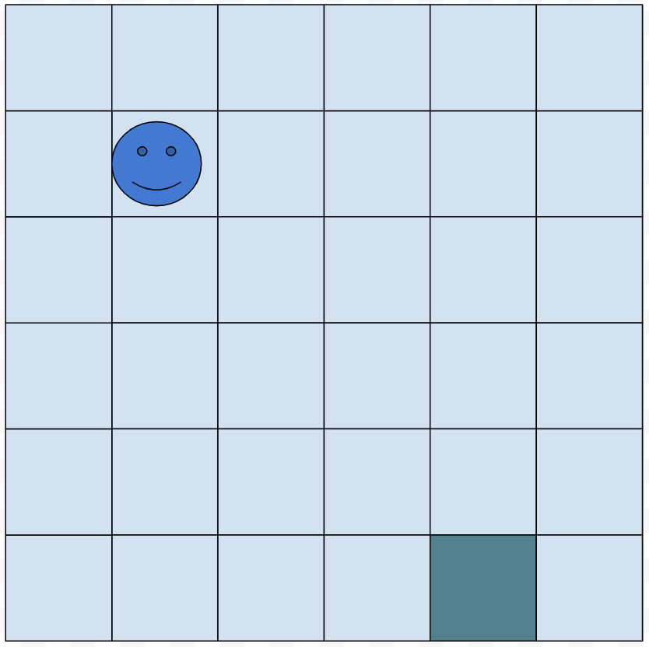
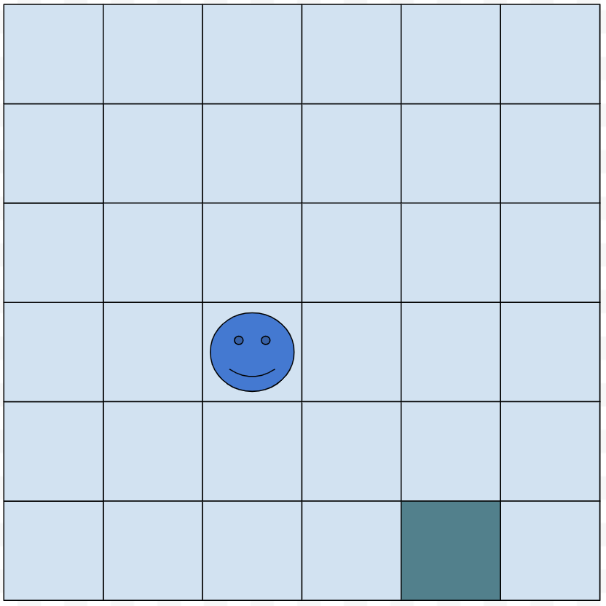
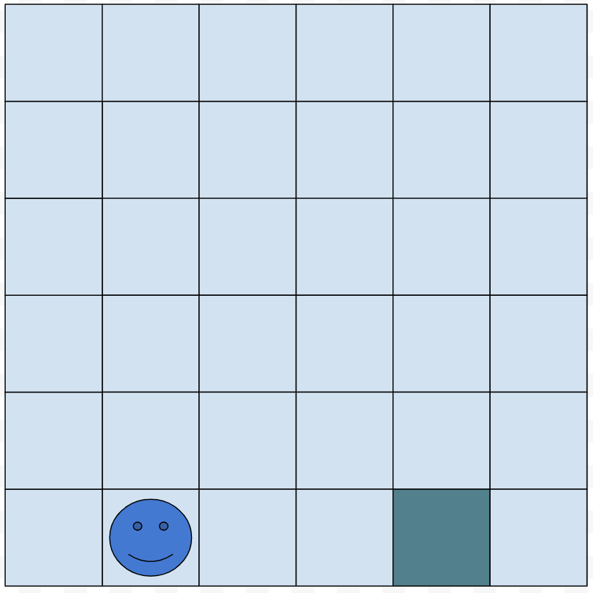
Dynamic Programming
Model is known
State is the current
configuration of the board: In
what square is the pacman.
Number of states: 36
Actions leading to final state has a reward of 100
Every other action has a reward of -1

Slide 19
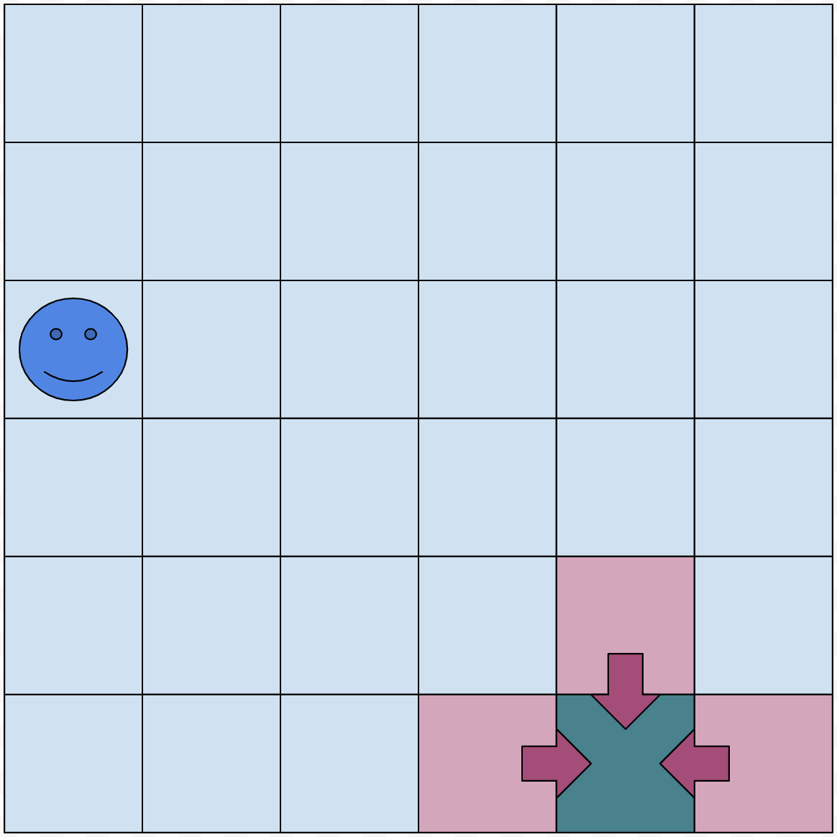
Dynamic Programming
Initialize all (state-action)
values to 0

Slide 20
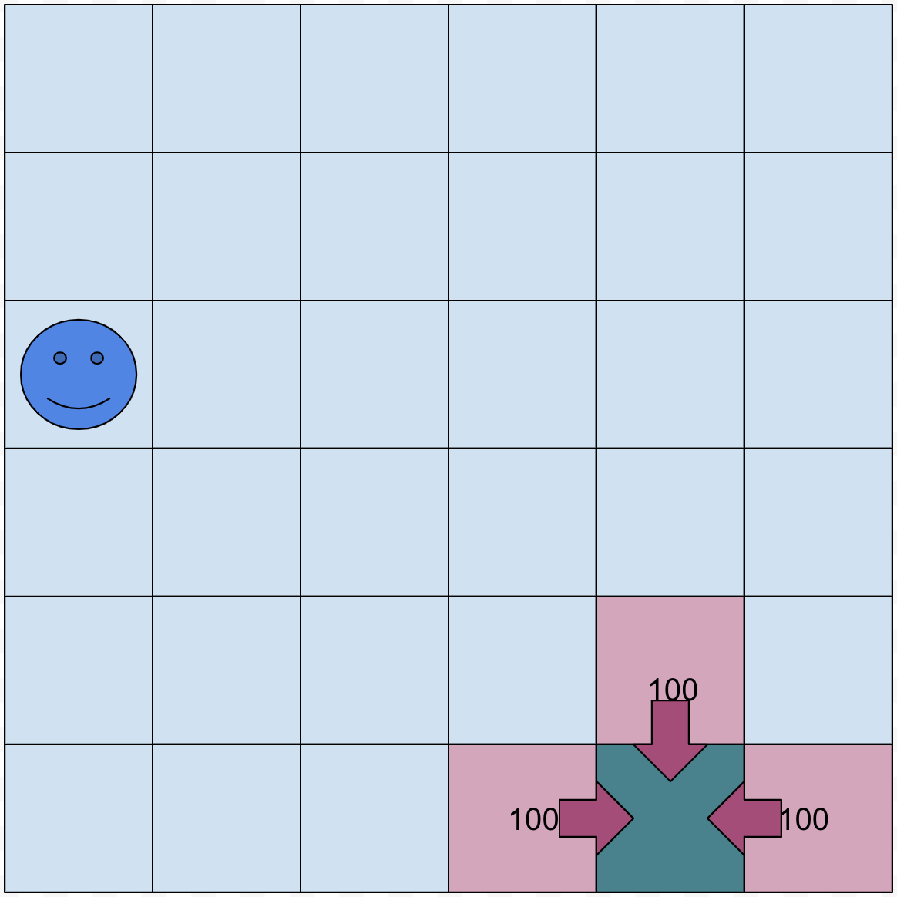
Dynamic Programming
Iterate through all
(state-action) pairs
to find re-evaluate
values

Slide 21
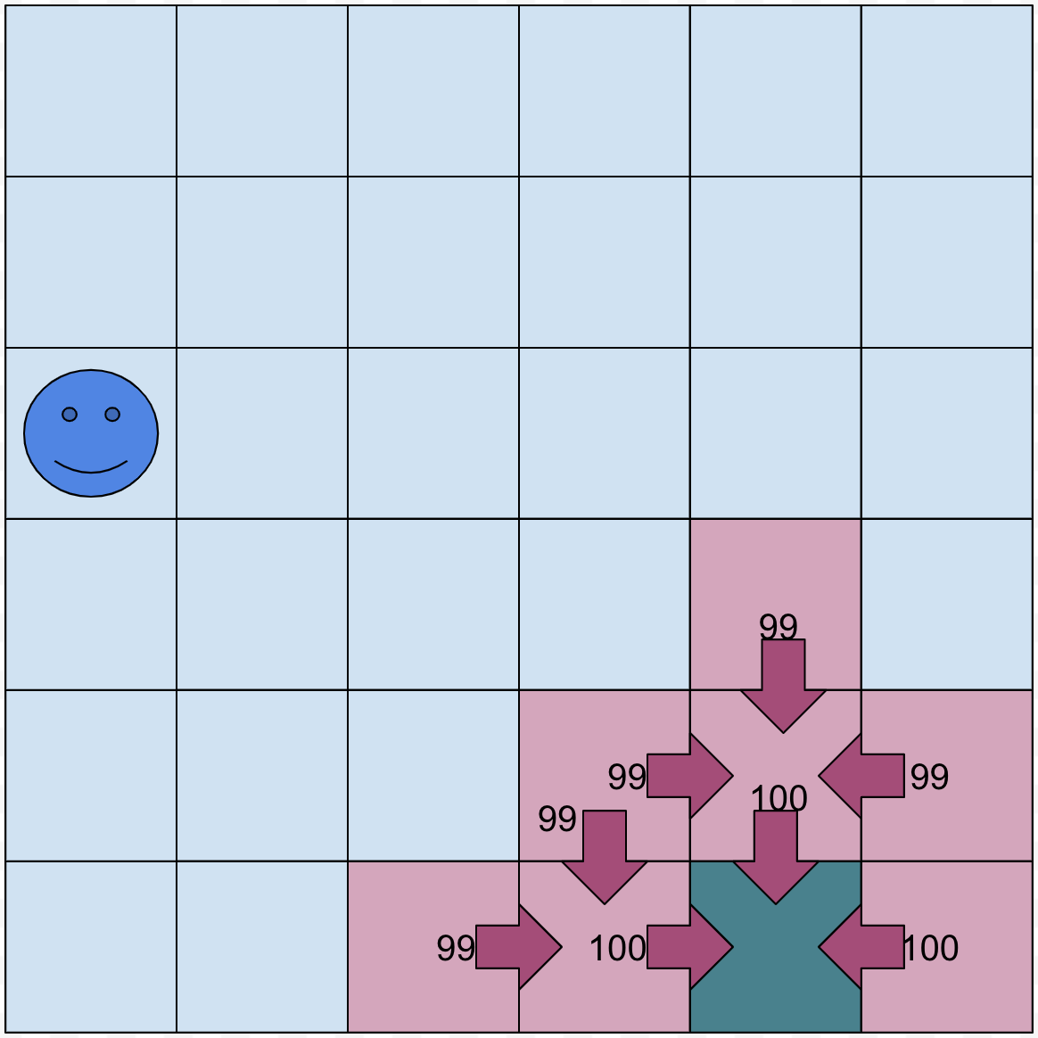
Dynamic Programming

Slide 22
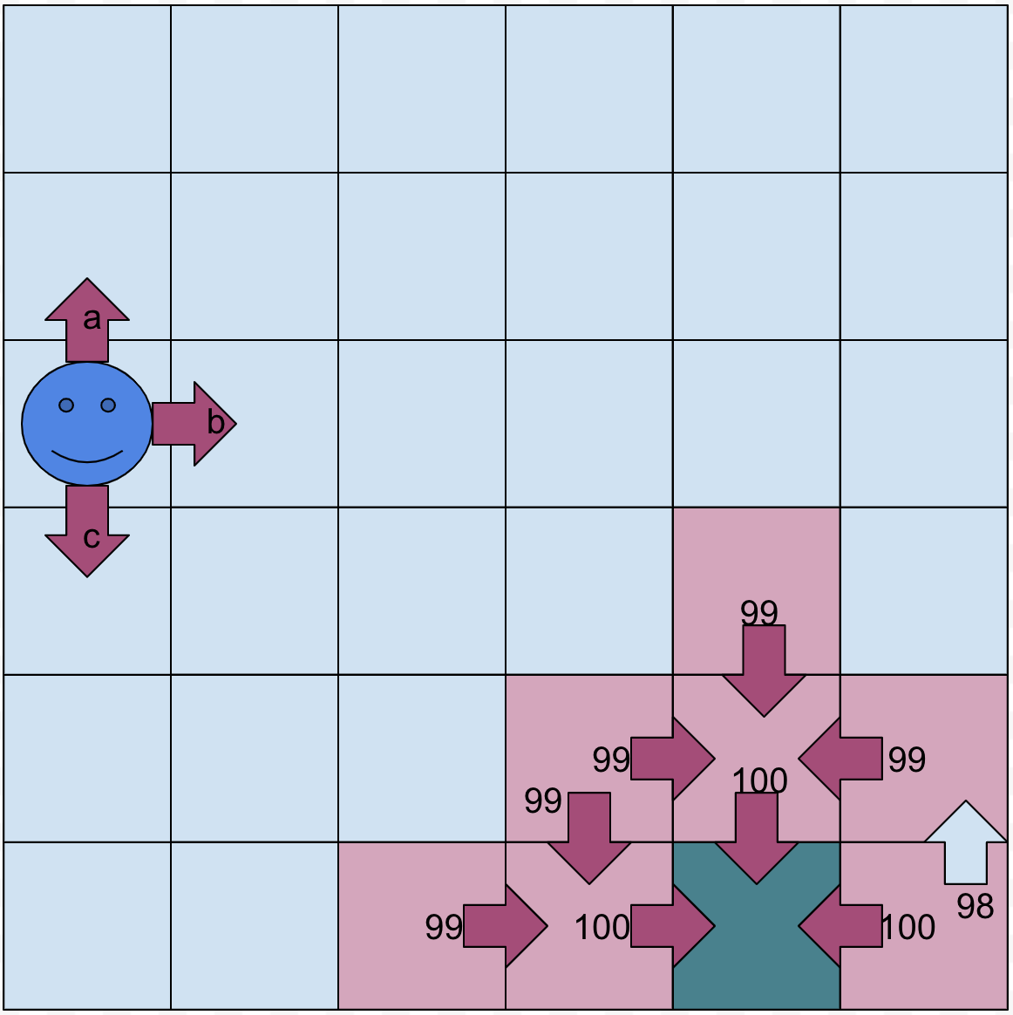
Dynamic Programming
After completion of all
(state-action) pairs repeat
process N times.

Slide 23
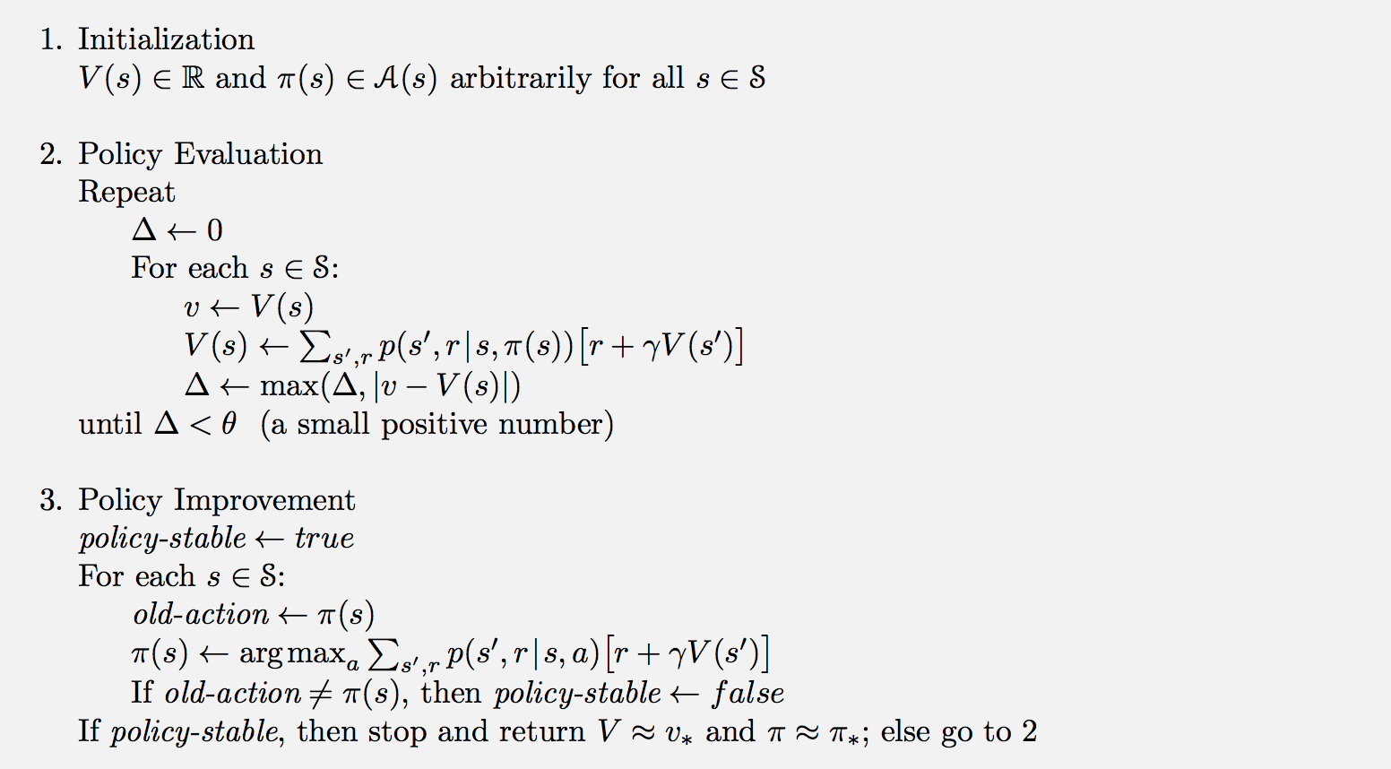
Dynamic Programming
Image retrieved from: Reinforcement Learning: An Introduction, Richard S. Sutton and Andrew G. Barto

Slide 24
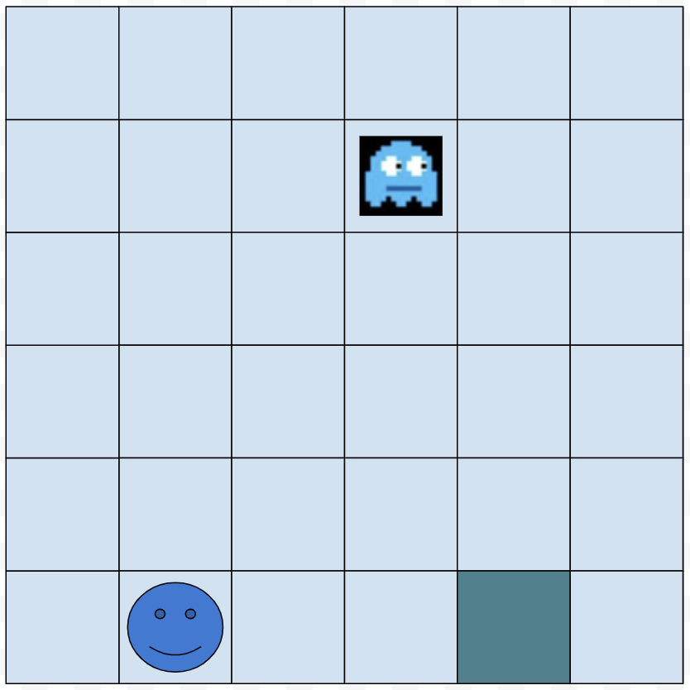
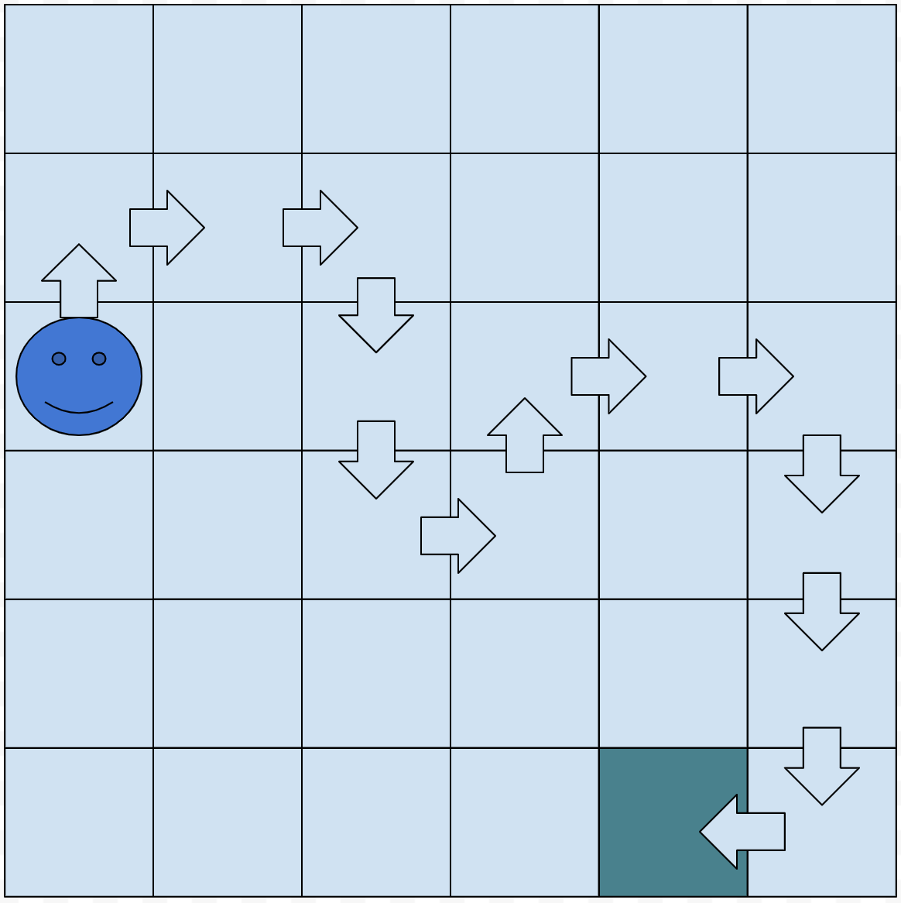

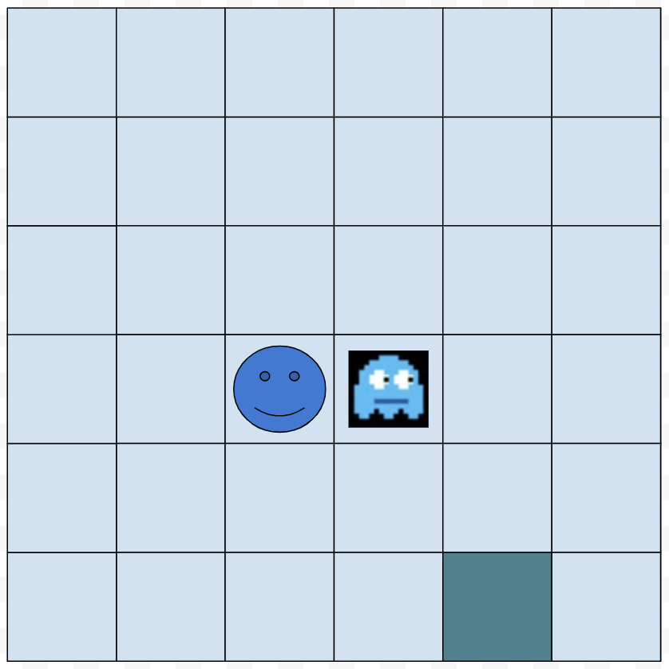
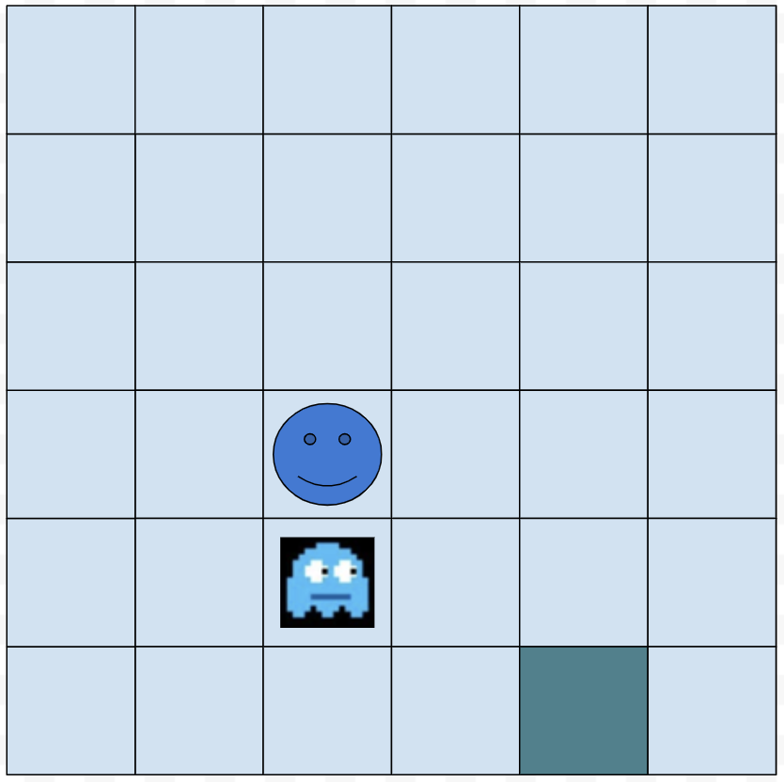
Monte Carlo Method
Model is no longer known
State is the current
configuration of the board: In
what square is the pacman +
where is the monster
Number of states increased
36 fold: 36 * 36
Being eaten by the monster is -300

Slide 25
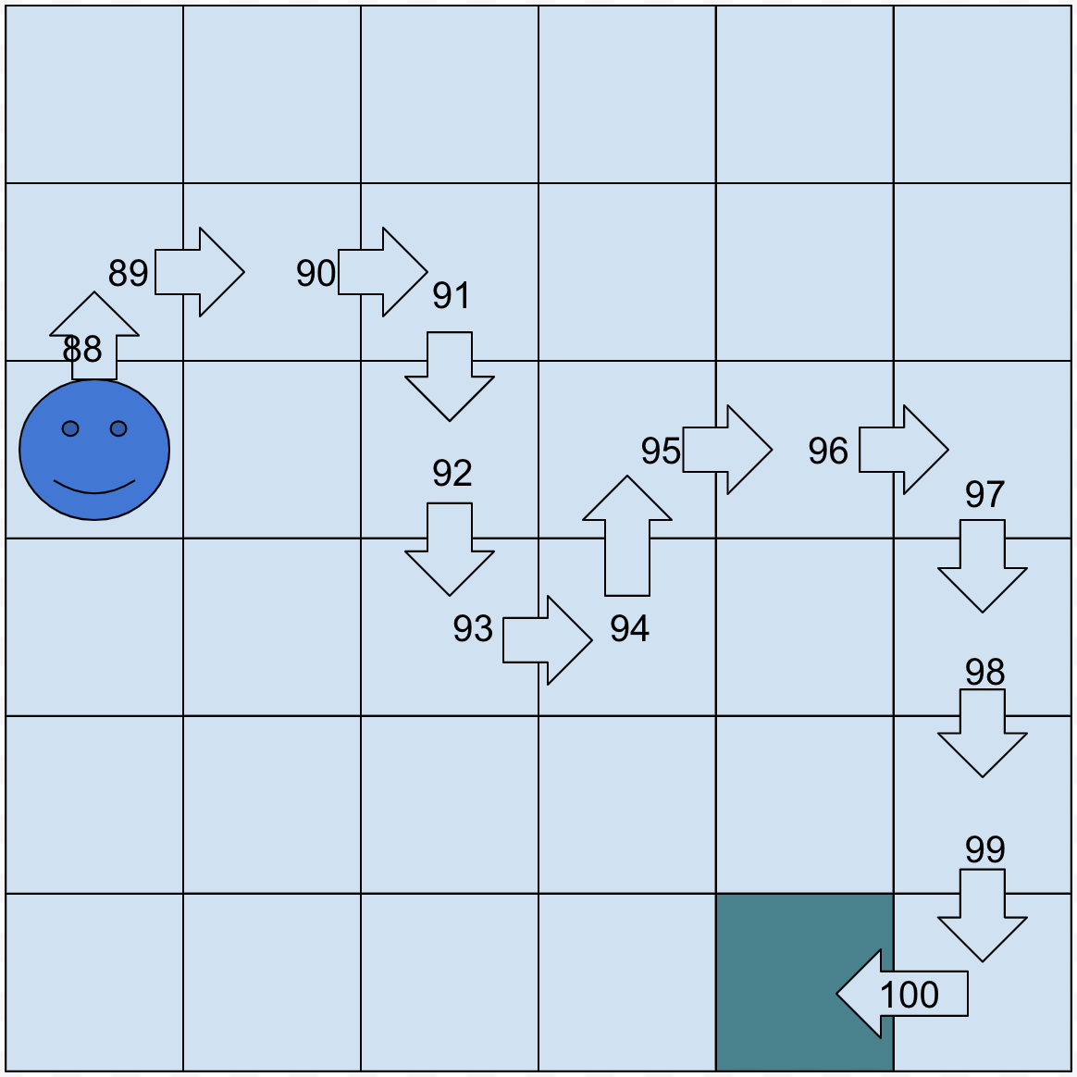
Monte Carlo Method
Initialize all (state-action)
values to 0
Initialize policy
(random movements)
Let it play until the terminal state
Re-evaluate the VISITED (state-value) pairs

Slide 26
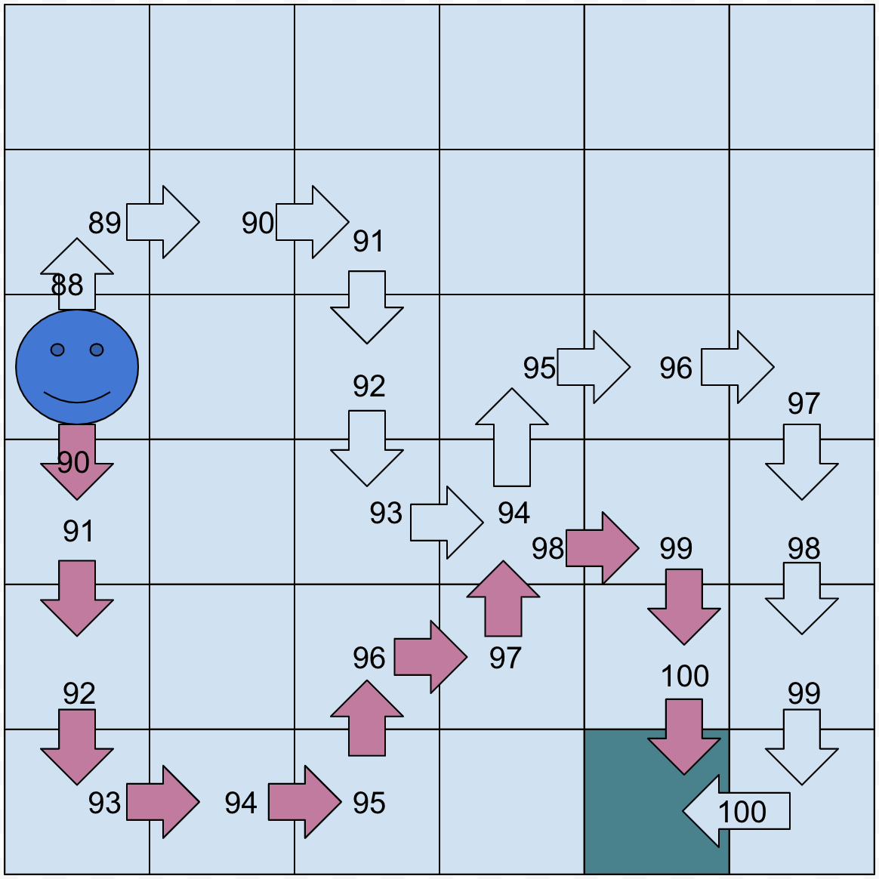
Monte Carlo Method
Update your policy
Play again
Repeat the process n times

Slide 27
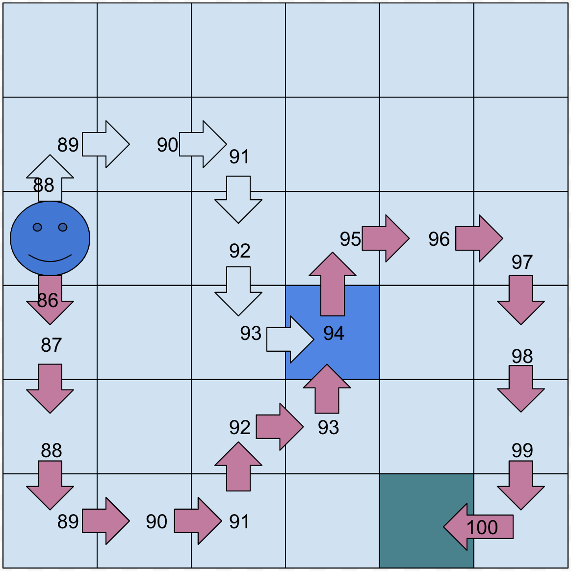
Monte Carlo Methods

Slide 28
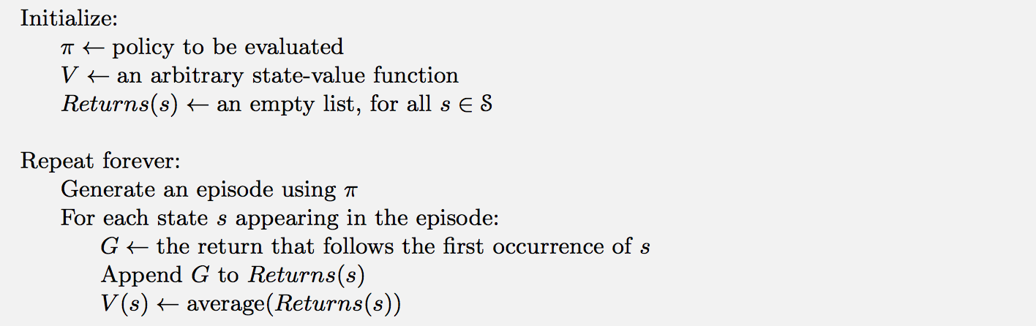
Monte Carlo
Image retrieved from: Reinforcement Learning: An Introduction, Richard S. Sutton and Andrew G. Barto

Slide 29
Temporal Difference
Initialize all values to a value
(Say 50 here)
Let it play
49
Update state-action pairs
AT EVERY STEP

Slide 30
Temporal Difference
49
49

Slide 31
Temporal Difference
49
49
49
49
49
49
49
49
49
49
49
150

Slide 32
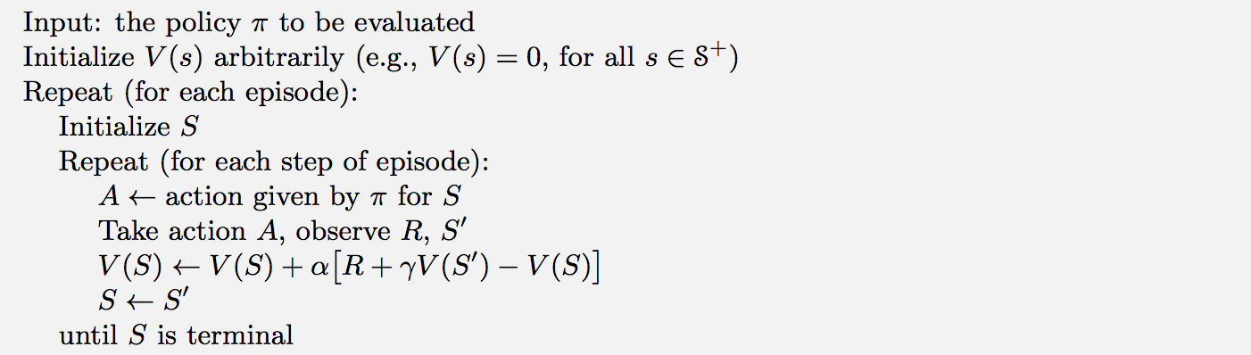
Temporal Difference Learning
Image retrieved from: Reinforcement Learning: An Introduction, Richard S. Sutton and Andrew G. Barto

Slide 33
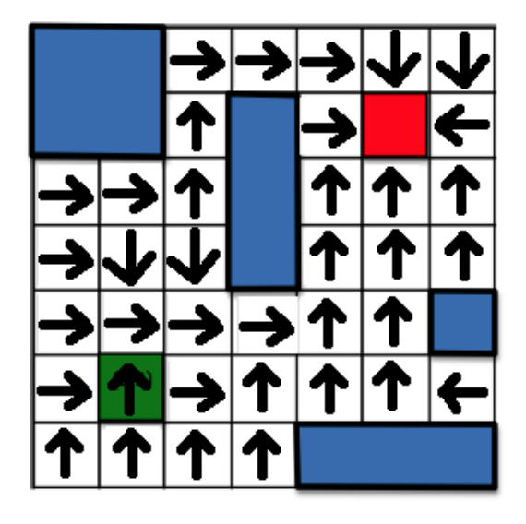
Example of an optimal policy
Image retrieved from http://home.deib.polimi.it/restelli/MyWebSite/pdf/rl2.pdf

Slide 34
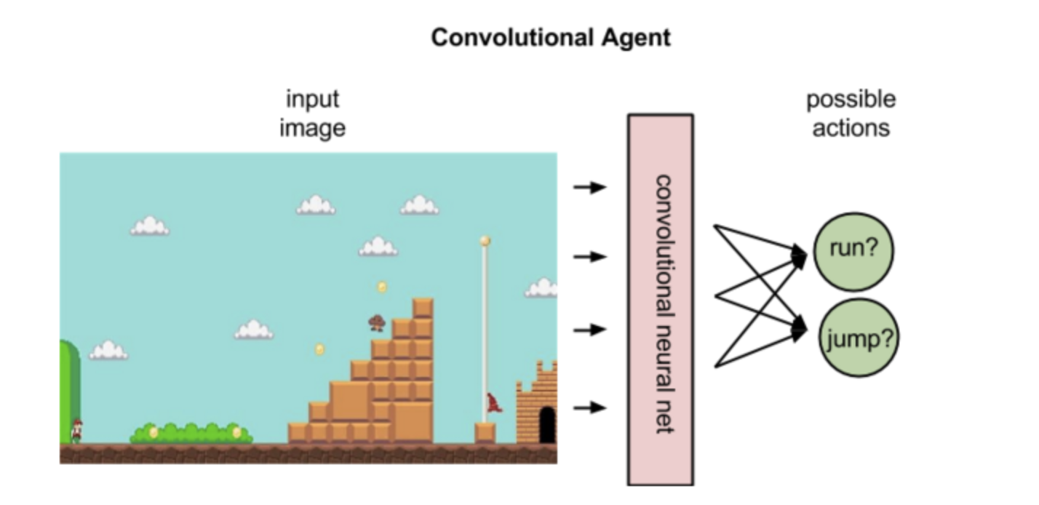
Deep Reinforcement Learning

Slide 35
Applications
Backgammon
Go
Chess
Videogames
Helicopter Steering
Robot Control

Slide 36
QUESTIONS
“The only stupid question is the one you never ask” - Rich Sutton!

